Slide 1
Text Mining with R, Chapter 9: Analyzing Usenet text

Slide 2
Usenet
Network communication system established in 1980 at UNC and Duke
Users post articles/messages to newsgroups organized by topic
These originally appear on the user’s local server, then propagate to other servers in a peer-to-peer fashion
Messages are organized into topical newsgroups (e.g., sci.space, talk.politics.mideast)
Messages in this case study are from 1993; drawn from a range of newsgroups

Slide 3
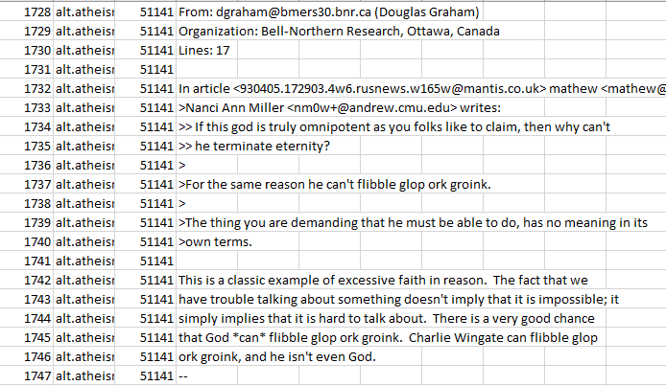
Pre-processing (before)
Need to get rid of text associated with each message that isn’t part of “main text” – e.g., to and from fields, previous messages quoted in the message body

Slide 4
Pre-processing
# include only messages that occur after the first occurrence of an empty line,
# and before the first occurrence of a line starting with --
cleaned_text <- raw_text %>%
group_by(newsgroup, id) %>%
filter(cumsum(text == "") > 0,
cumsum(str_detect(text, "^--")) == 0) %>%
ungroup()
# removes rows containing quotes of previous messages, which start with “>”, “writes:”, ”writes…”, or “In article <“
cleaned_text <- cleaned_text %>%
filter(str_detect(text, "^[^>]+[A-Za-z\\d]") | text == "",
!str_detect(text, "writes(:|\\.\\.\\.)$"),
!str_detect(text, "^In article <"),
!id %in% c(9704, 9985))
Notes:
- First code block keeps rows that follow the first occurrence of empty line, and before first occurrence of line starting with --; gets rid of to, from, and organization fields
- Second code block removes previous messages, which are signified by “writes:” or “writes…” or “In article”

Slide 5
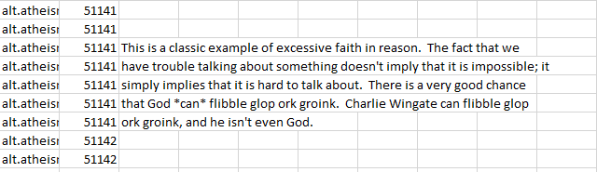
Pre-processing (after)

Slide 6
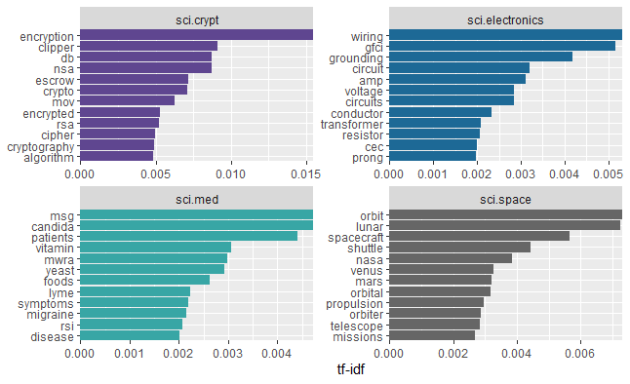
Tf-idf within newsgroups
Used bind_tf_idf() function to create new tibble with tf-idf for each newsgroup-word combination
Filtered by science-related newsgroups and plotted the 12 highest words by tf-idf for each newsgroup

Slide 7
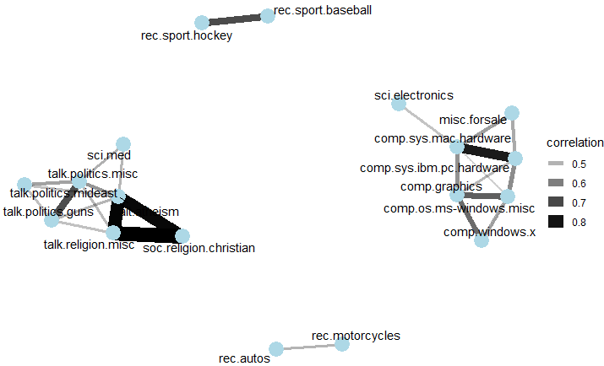
Pairwise correlations of word frequencies
Used pairwise_cor() function from widyr package to calculate word frequency correlations between each pair of newsgroups
Then used ggraph() to create a network graph with newsgroups as nodes and correlations as edges (limited to correlations > 0.4)

Slide 8
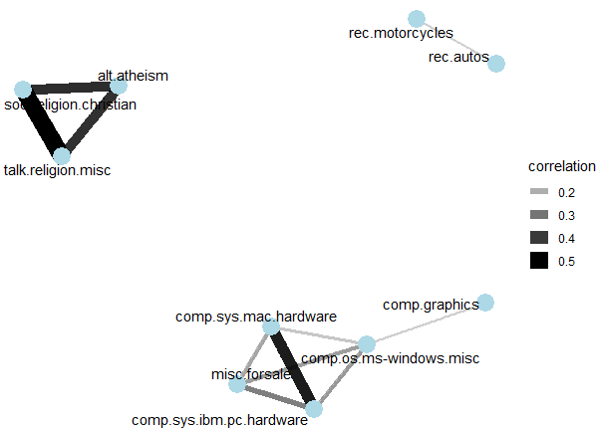
Exercise 1: Pairwise correlations of tf-idf
Using the pairwise_cor() function, calculate correlations of tf-idf for each pair of newsgroups
Then create a network graph of all the correlations greater than 0.1

Slide 9
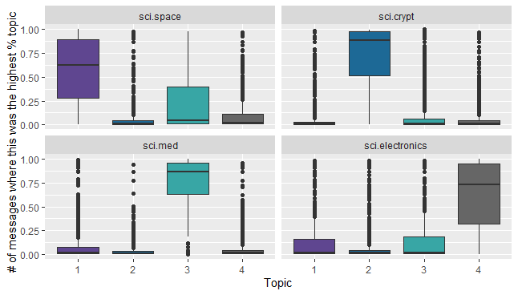
Topic modeling
For science newsgroups, calculated # of times each word occurred within each message
Converted to document-term matrix and conducted LDA with four topics
Then for each combination of topic and science newsgroup, plotted distribution of gammas (i.e., proportion of words within a given message generated by a given topic)

Slide 10
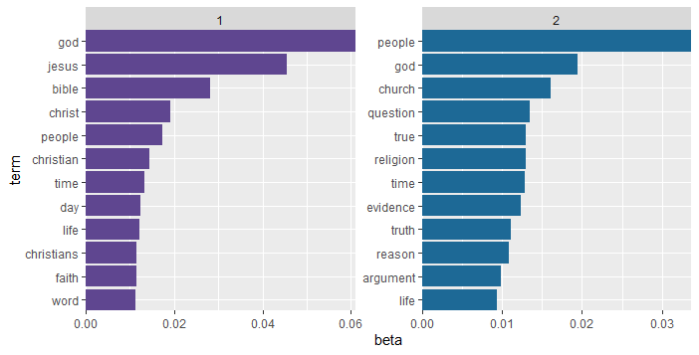
Exercise 2a: Religion newsgroup topics
rel_lda is an LDA object with 2 topics generated by analyzing messages from the three religion newsgroups (alt.atheism, soc.religion.christian, talk.religion.misc)
Create a column graph that displays, for each topic, the words with the highest 12 betas

Slide 11
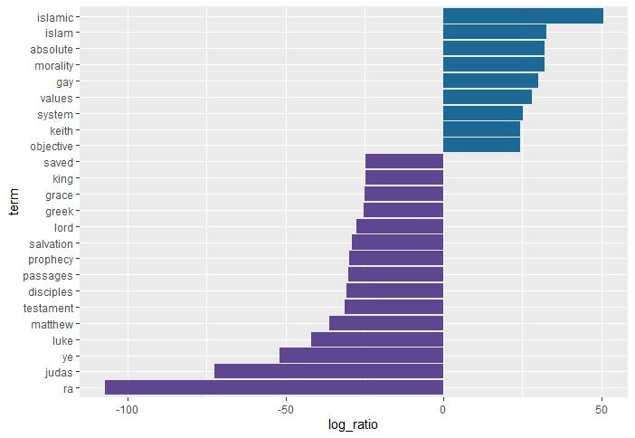
Exercise 2b: Religion newsgroup topics
Calculate log ratio of each word's beta for topic 1 to its beta for topic 2, then graph the 24 words with highest absolute values of these log ratios (throwback to Chapter 6)

Slide 12
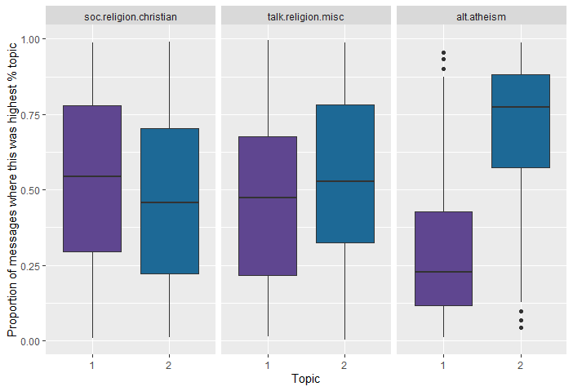
Exercise 2c: Religion newsgroup topics
Create boxplots of gamma for each combination of topic and religion newsgroup

Slide 13
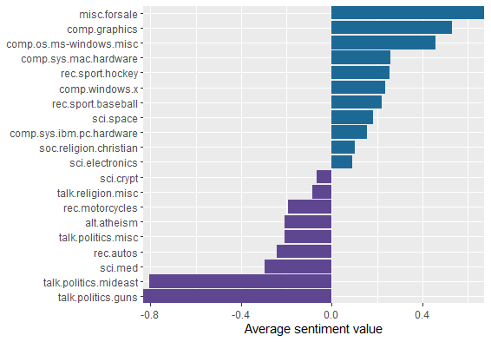
Sentiment analysis
Used AFINN lexicon to determine which newsgroups had highest and lowest average sentiments

Slide 14
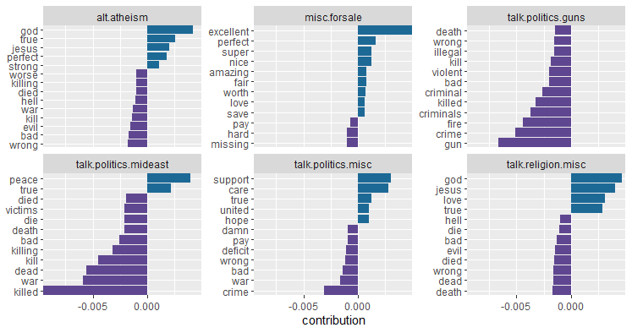
Words contributing most to sentiment
Overall and within newsgroups, plotted words that were most positive/most negative

Slide 15
Sentiment analysis by message
Calculated average sentiment within each message; allowed them to examine messages with most positive and most negative average sentiment
Most negative:
#> Losers like us? You are the f****** moron who has never heard of the Western
#> Business School, or the University of Western Ontario for that matter. Why
#> don't you pull your head out of your a****** and smell something other than
#> s*** for once so you can look on a map to see where UWO is! Back to hockey,
#> the North Stars should be moved because for the past few years they have
#> just been S***. A real team like Toronto would never be moved!!!
#> Andrew--

Slide 16
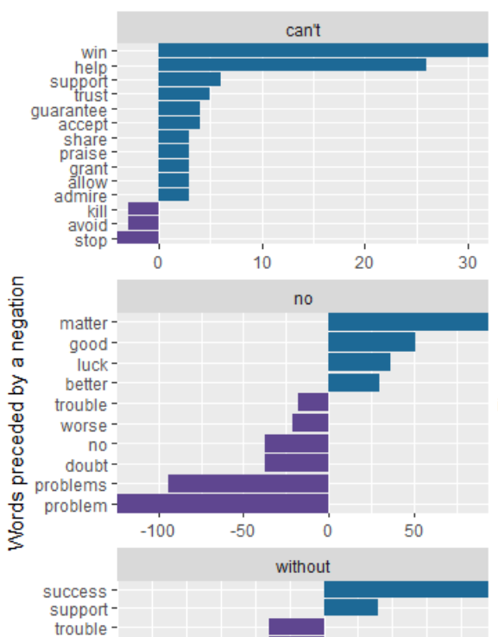
N-gram analysis
Created a tibble of bigrams to investigate impact of six negation words (“no,” “not”, etc.); used this to plot the positive and negative words that most often followed these negations
negate_words <- c("not", "without", "no", "can't", "don't", "won't")
usenet_bigram_counts %>%
filter(word1 %in% negate_words) %>%
count(word1, word2, wt = n, sort = TRUE) %>%
inner_join(get_sentiments("afinn"), by = c(word2 = "word")) %>%
mutate(contribution = value * n) %>%
…

Slide 17
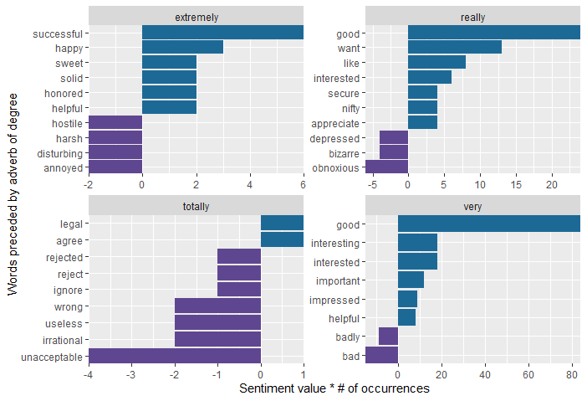
Exercise 3: Adverbs of degree
“Adverbs of degree” (such as “very”) may enhance sentiment in either direction (“very unhappy,” “really excited”)
For the science newsgroups only, plot the 8 words (positive and negative combined) that most often followed each of these adverbs: “extremely,” “really,” “totally,” “very”

